Slide 1
Analyzing OpenFEMA's Disaster Declarations: A Summary of Major Disasters

Slide 2
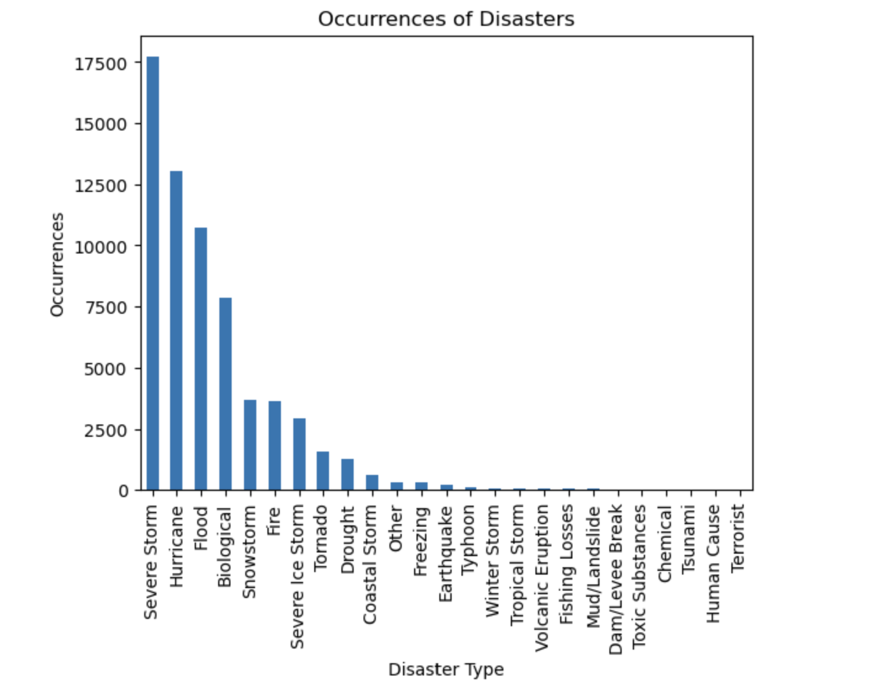
Unraveling Disaster Types and Frequencies
Severe Storm , The most frequently reported disaster, with a total of 17,705 instances.
Following closely behind are Hurricane with 13,046 occurrences and Flood with 10,722 occurrences.
The least frequently reported events include Terrorist with 5 occurrences, Human Cause with 7 occurrences, and Tsunami with only 9 occurrences.

Slide 3
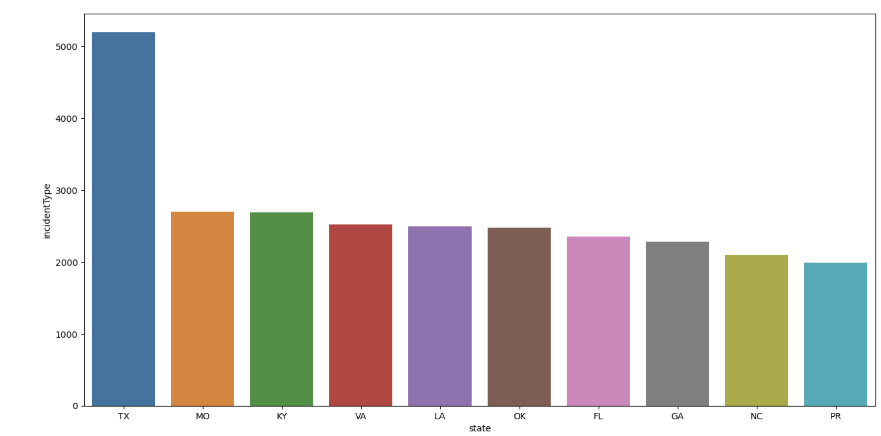
States at Risk: Unveiling the Most Disaster-Prone Regions
Texas (TX) emerges as the state with the highest number of reported incidents, with a total of 5,195 occurrences.
Missouri (MO) closely follows with 2,702 incidents, while Kentucky (KY) reports 2,693 incidents.
Virginia (VA) and Louisiana (LA) exhibit a significant risk profile, each reporting 2,524 and 2,493 incidents, respectively.
The chart also reveals that Oklahoma (OK), Florida (FL), Georgia (GA), North Carolina (NC), and Puerto Rico (PR) are states prone to disasters, with reported incidents ranging from 2,480 to 1,987 occurrences.
Understanding high-risk regions is crucial for resource allocation, prevention, and improved disaster response capabilities.

